Slide 1
DATA STRUCTURES
Presented by:
Nishita Panchal – C057
Manav Patel – C063
Krisha Shah – C073
Nisarg Sheth – C080

Slide 2
AIM Aim is to provide Student Registration for different Courses in an Engineering Institute. And to keep a Record of Registrations of the Students.

Slide 3
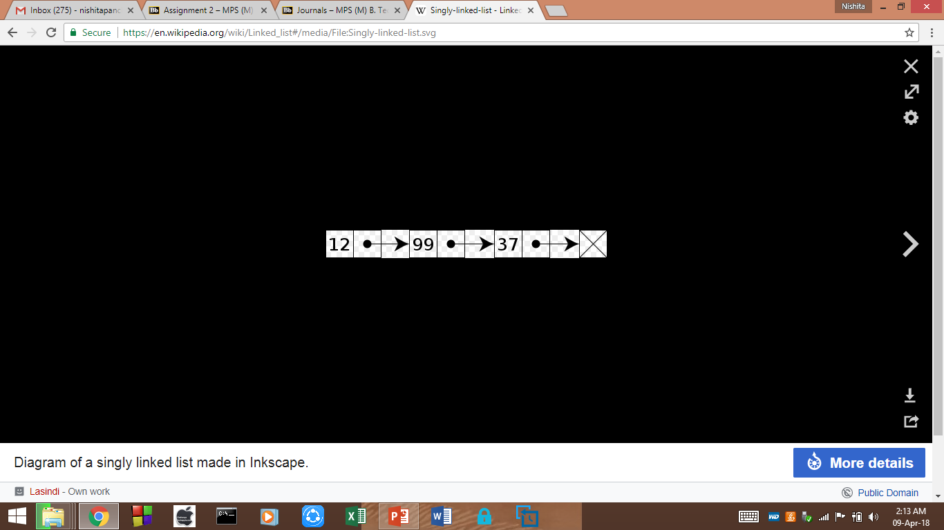
APPLICATION We have used Linked List which is an application of Data Structure. Linked list is a linear collection of data elements, in which linear order is not given by their physical placement in memory. Instead, each element points to the next. It is a data structure consisting of a group of nodes which together represent a sequence.

Slide 4
FUNCTIONS IN THE CODE
The following are the functions in the code:
1. double calculate_aggregiate(student *stud);
2. void addToList(student *stud , list *ls);
3. bool register_student(student *stud , list *ls);
4. void deleteFromList(list *l);
5. void showList(student *stud , list *l);

Slide 5
CODE
#include<iostream>
#include<string.h>
using namespace std;
struct student
{
char name[20];
int maths;
int science;
int english;
int entryTest;
student *next;
};
struct list
{
char name[20];
double aggr;
list *next;
};

Slide 6
double calculate_aggregiate(student *stud)
{
student *s = stud;
double aggr;
aggr = (s -> maths*25/100) + (s -> science*25/100) + (s -> english*10/100) + (s -> entryTest*40/100);
return aggr;
}
void addToList(student *stud , list *l)
{
list *head = l;
while(head -> next != NULL)
{
head = head -> next;
}
head -> next = new list;
head = head -> next;
strcpy(head -> name , stud -> name);
head -> aggr = calculate_aggregiate(stud);
head -> next = NULL;
}

Slide 7
bool register_student(student *stud , list *ls) { student *s = stud; cout<<"\nWrite the name of the Student\n"; cin>>s -> name; cout<<"\nEnter the marks for Maths , Science and English: \n"; cout<<"Maths: "; cin>>s -> maths; cout<<"Science: "; cin>>s -> science; cout<<"English: "; cin>>s -> english; cout<<"Enter marks scored in Entrance Exam: "; cin>>s -> entryTest; double aggregiate; aggregiate = calculate_aggregiate(s); cout<<"\nAggregiate percentage is: "<<aggregiate<<"\n";

Slide 8
if (aggregiate >= 70) { cout<<"\nCongratulations! You are eligible for Computers , Electronics or Mechanical\n"; addToList(s , ls); return true; } else if (aggregiate >= 60) { cout<<"\nCongratulations! You are eligible for Electronics or Mechanical\n"; addToList(s , ls); return true; } else if (aggregiate >=50) { cout<<"\nCongratulations! You are eligible for Mechanical\n"; addToList(s , ls); return true; } else { cout<<"\nSORRY, the student can't be registered in engineering\n"; return false; } }

Slide 9
void deleteFromList(list *l) { list *head = l; list *ptr = new list; list *prev = new list; list *temp = new list; char k[20]; char sure = 'n'; cout<<"\nEnter the name of the student to be deleted: \n"; cin>>k; prev = ptr = head; while(strcmp(ptr -> name , k) != 0) { prev = ptr; ptr = ptr -> next; if(ptr == NULL) break; }

Slide 10
if(ptr != NULL) { cout<<"\nAre you sure you want to delete...Confirm[y/n]: "; cin>>sure; if(sure == 'y') { if(ptr == head) { temp = head -> next; delete head; head = temp; } temp = ptr -> next; delete ptr; prev -> next = temp; cout<<"\nRecord Deleted\n"; } else if(sure == 'n') { cout<<"\nRecord not Deleted\n"; } } else { cout<<"\nNo Matching Registration Found\n"; } }

Slide 11
void showList(student *stud , list *l) { list *head = l; int count = 7032100; if(head -> next == NULL) { cout<<"\nNo student registered yet!\n"; } else { cout<<"\nStudent Registration List:\n"; cout<<"\nCourse: B-Tech (INTEGRATED)"<<endl; cout<<"\nYear: 2018-19"<<endl; cout<<"\nStudent Name\tStudent Number\tAggregiate\tEligible Courses\n\n"; while(head -> next != NULL) { count++; head = head -> next; cout<<head -> name<<"\t\t"; cout<<count<<"\t\t"; cout<<head -> aggr<<"\t\t"; if (head -> aggr >= 70) { cout<<"CS EXTC MECH\n"; } else if (head -> aggr >= 60) { cout<<"EXTC MECH\n"; } else if (head -> aggr >=50) { cout<<"MECH\n"; } } } }

Slide 12
int main() { cout<<"SHRI VILE PARLE KELAVANI MANDAL'S NARSEE MONJEE INSTITUTE OF MANAGEMENT STUDIES\n\n\t\t\tMUKESH PATEL SCHOOL OF ENGINEERING\n"; cout<<"\n"; cout<<"Student Registration"<<endl; cout<<"Course: B-Tech (INTEGRATED)"<<endl; cout<<"Year: 2018-19\n"<<endl; student *s = new student; list *ls = new list; ls -> aggr = 0; ls -> next = NULL; int choice;

Slide 13
do { cout<<"\n---------------------MENU-----------------------"; cout<<"\n| Press"<<" |"<<endl; cout<<"| [1] To Register"<<" |"<<endl; cout<<"| [2] To Display the list"<<" |"<<endl; cout<<"| [3] To Delete registration"<<" |"<<endl; cout<<"| [4] to quit"<<" |"<<endl; cout<<"------------------------------------------------\n"; cout<<"Enter your choice: "; cin>>choice; switch(choice) { case 1: register_student(s , ls); break; case 2: showList(s , ls); break; case 3: deleteFromList(ls); break; } } while(choice != 4); return 0; }

Slide 14
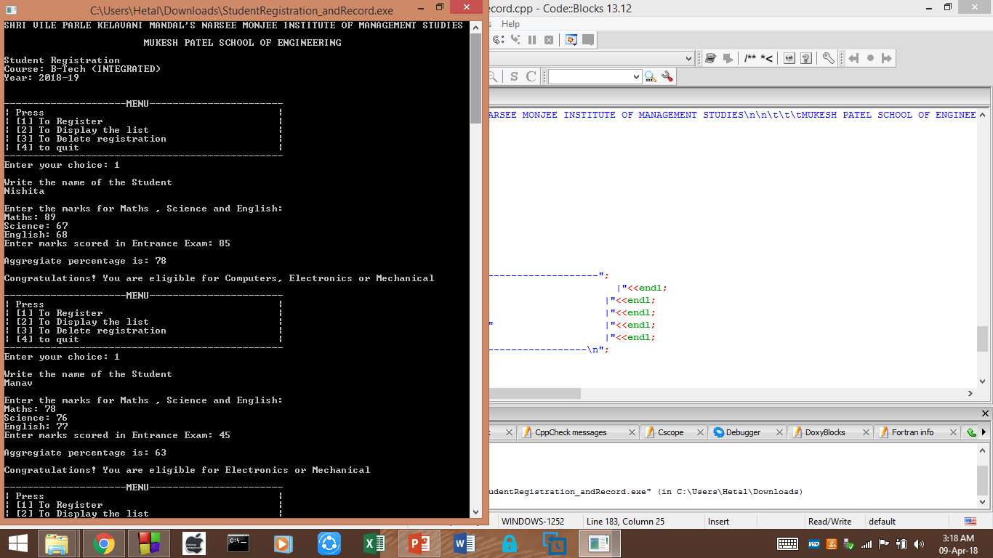
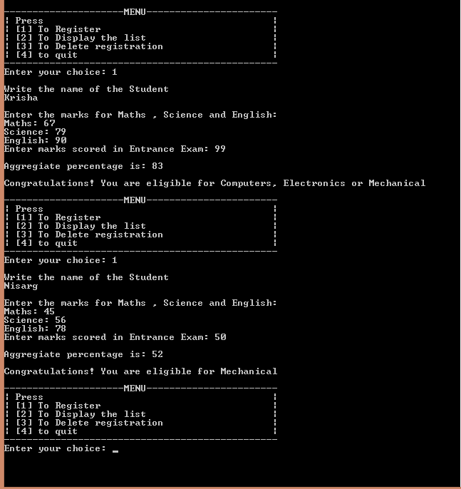
OUTPUT

Slide 15
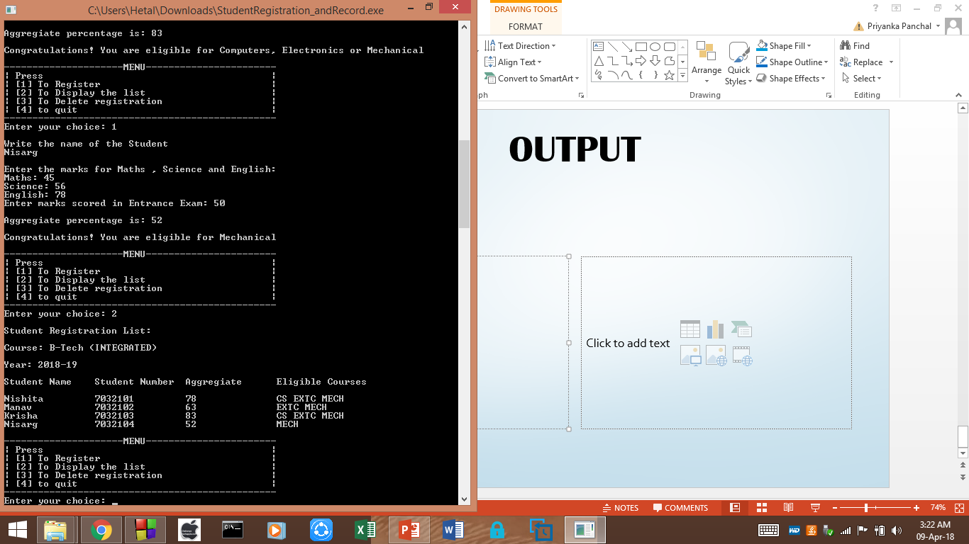
OUTPUT

Slide 16
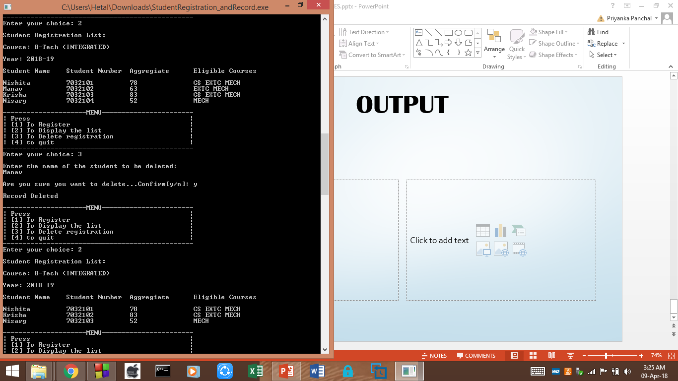
OUTPUT

Slide 17
THANK YOU..!!!!

